Slide 1
ACM SAC 2020
By Tomas Cerny
Baylor University, TX
ICPC lead developer
10+ years organizing World Finals
How TO FAIL with Success
Almost in BRNO, Czech Republic

Slide 2
ACM SAC’20
March 30-April 3, 2020
400 attendees
350 full papers
50 posters
Czechia first in Europe to close its borders on 16 March.
A week before all large events closed!

Slide 3
ACM SAC’20 : Timing
This was our operation period to come with a backup plan B
March 30-April 3, 2020
400 attendees
350 full papers
50 posters
The first in Europe to close its borders on 16 March.
A week before all large events closed!

Slide 4
ACM SAC’20 : Timing
We were already thinking to cancel before that time!
This was our operation period to come with a backup plan
March 30-April 3, 2020
400 attendees
350 full papers
50 posters
The first in Europe to close its borders on 16 March.
A week before all large events closed!

Slide 5
ACM SAC’20 : Timing
We were already thinking to cancel before that time!
This was our operation period to come with a backup plan
March 30-April 3, 2020
400 attendees
350 full papers
50 posters
The first in Europe to close its borders on 16 March.
A week before all large events closed!
Who reimburses travel expenses to participants?

Slide 6
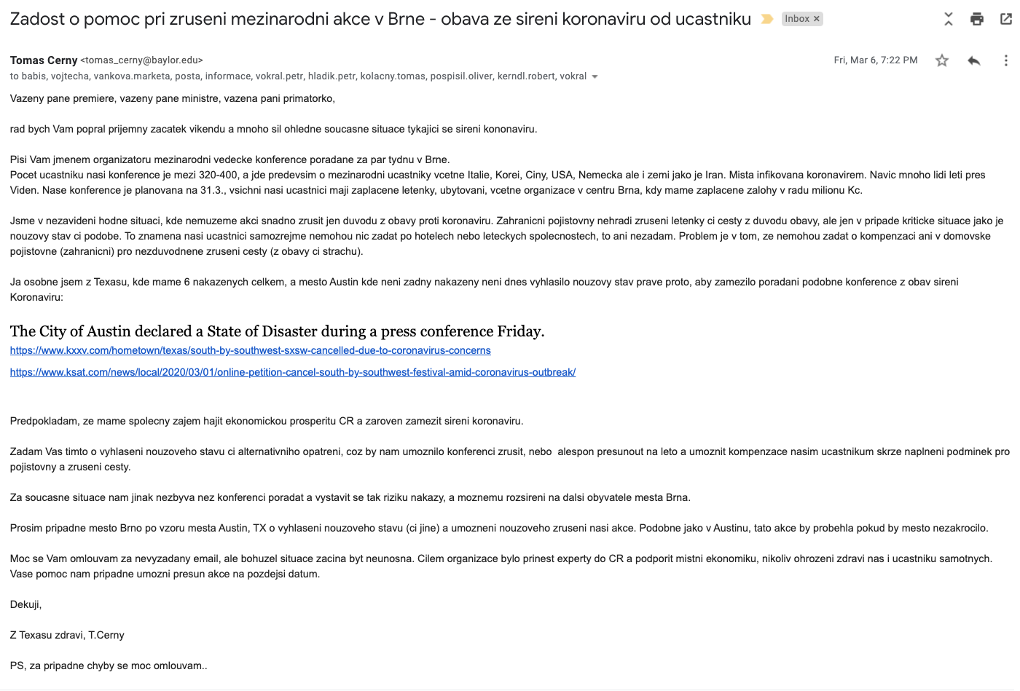
Implications : Financial issue
3-4 emails to the prime minister and minister of health
4-day response
Large events shutdown
Hotel had to cancel the venue

Slide 7
Implications : Financial issue
March 6
3-4 emails to the prime minister and minister of health
4-day response
Large events shutdown
Hotel had to cancel the venue
March 10
State of emergency

Slide 8
Implications : Financial issue
Why do I mention it?
Hotel + Venue had to cancel!
Virtually $0 costs!!!!
Full refund for registration fee!!
March 6
3-4 emails to the prime minister and minister of health
4-day response
Large events shutdown
Hotel had to cancel the venue
March 10
State of emergency

Slide 9
Plan B : Options
Cancel the conference
Liable for plane tickets?
State emergency solved our issue
Virtual conference
How?
Zoom
Offline
No solution for that
400 participants

Slide 10
Plan B : Options
Virtual conference
Zoom
Issue: international audience, lecture at 3 am?
Offline
No solution for that, we knew off
400 participants

Slide 11
Custom solution
Web system with personal space for each presenter to post video/slides
Listed by track (40+ tracks)
Listed by sessions / author
As on original schedule
3 weeks to build!

Slide 12
Organization
Google form - to collect information from attendees and track chairs
Links to video/slides
Metadata – similar to the registration process
Fixed set of tracks
https://forms.gle/UGj7UfbDzd1oc5uh7
Develop new system
Import data from users (GForms)
Restricted access (later we allowed public access with hidden metadata)
4 skilled developers
Microservice backend / client-side frontend / containerized -> cloud computing
Not meant for a single time use! Well-scalable, best practice, SECURED, PRIVACY, STRESS TESTED!

Slide 13
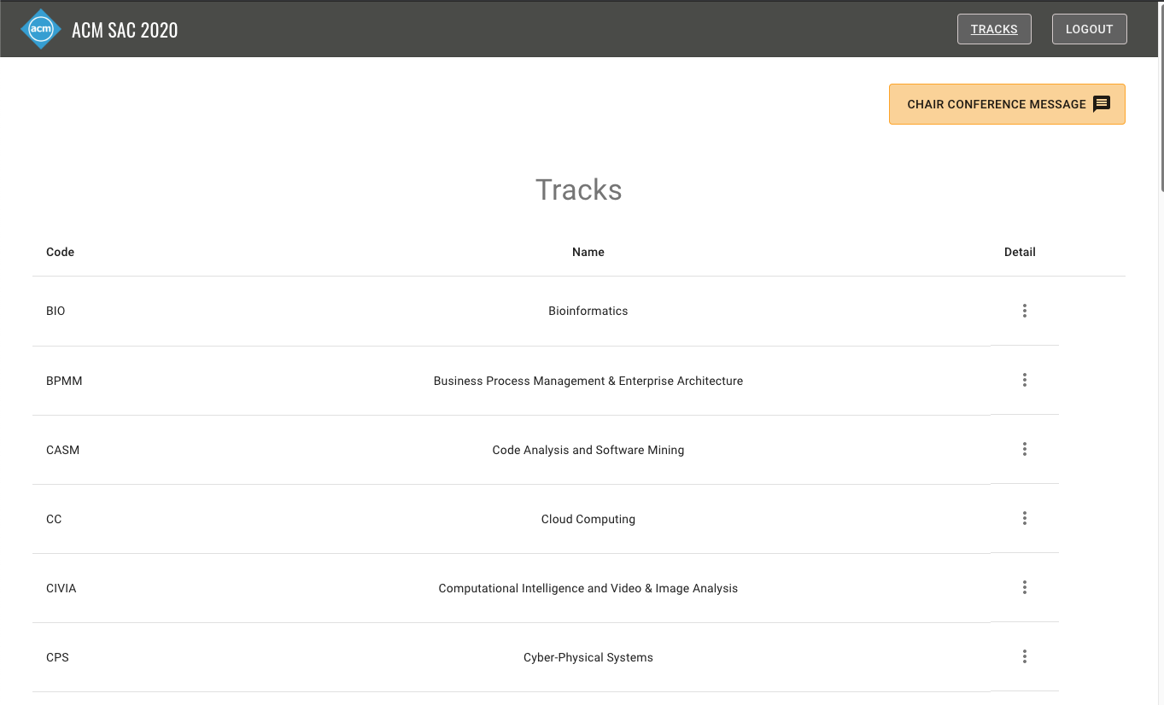
Our ACM Conference system
Track list
Open-Source
https://github.com/cloudhubs/acmsac
Live [tour]
https://acmsac.ecs.baylor.edu/#/
Demo + developers
scheduled in few minutes!!!

Slide 14
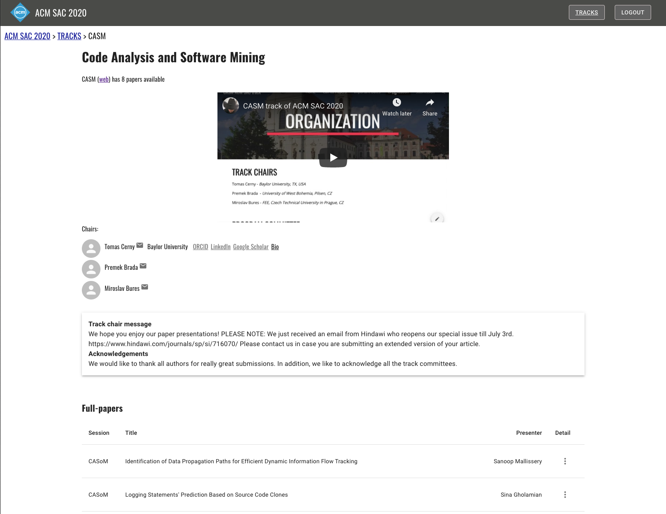
TRACK details
Each track chair
could upload a message
Video, meta-data

Slide 15
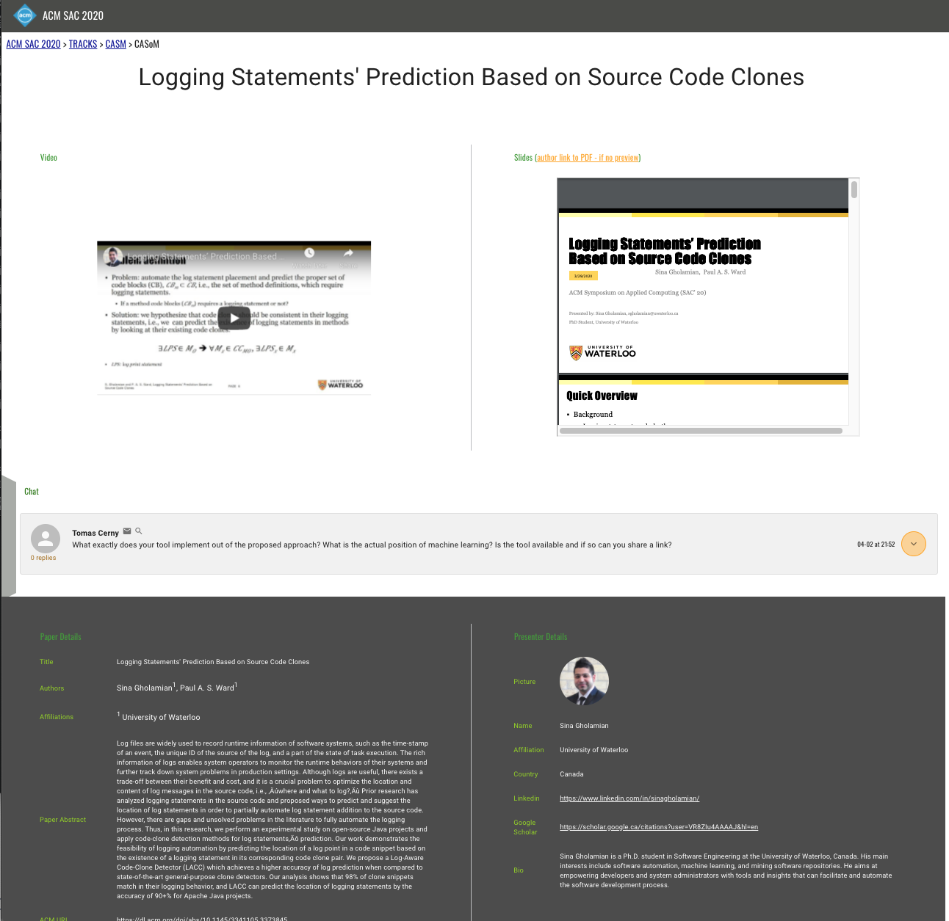
Author Presentations
Video
Presentation
Chat with others
Presenter details
Paper metadata
Link to ACM!
Email!
LinkedIn/Scholar profiles

Slide 16
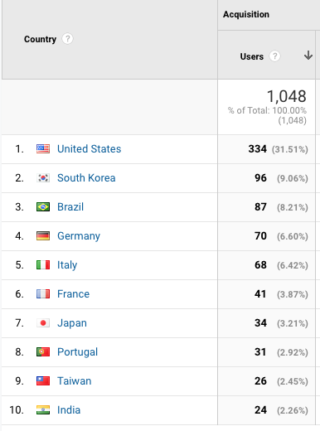
Stats
New OSS for conferences
Works and preforms great but could have improvements
Content modification
Easy but not implemented
Google analytics
1,048 users
2,582 sessions
20,428 pageviews
~100 comments posted

Slide 17
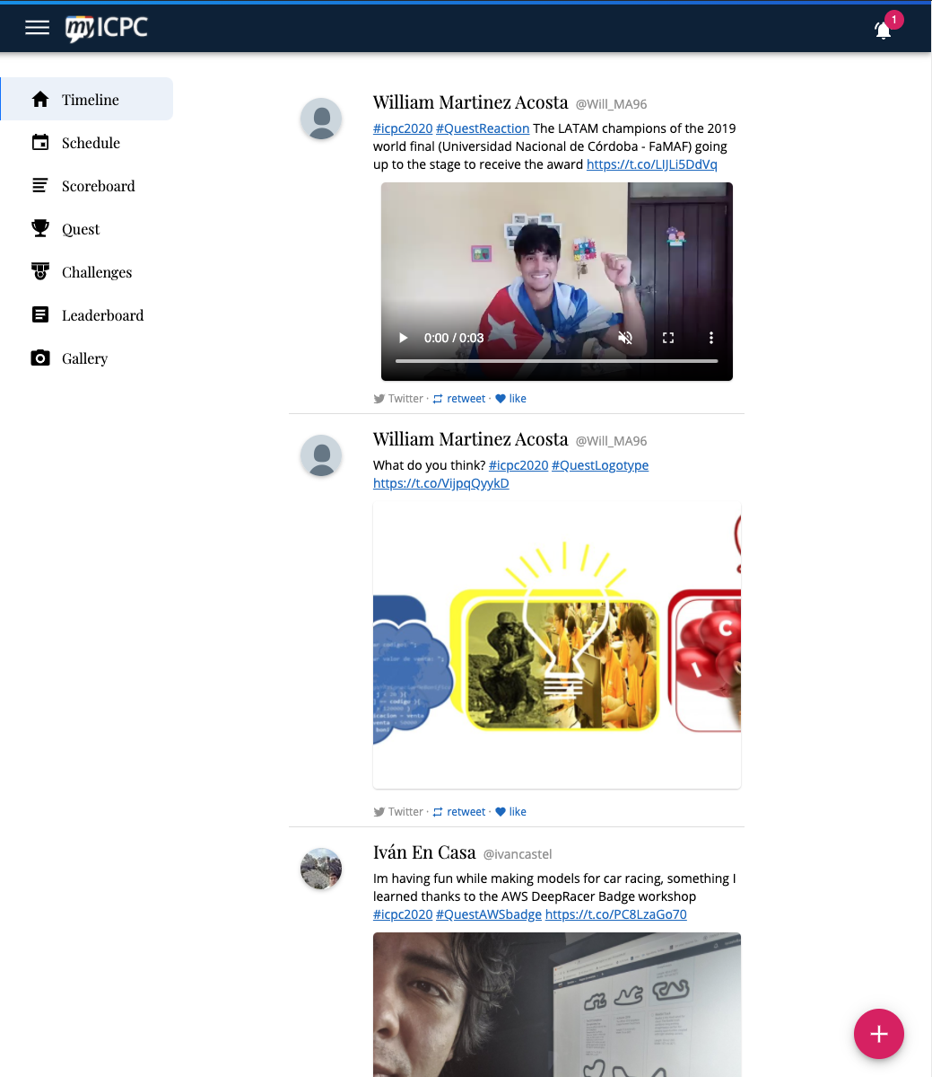
Context and FUTURE solutions
SECOND SCREEN experience!
ICPC – MyICPC (since 2012)
Programming Contests
Lead developer
my.icpc.global

Slide 18
Conclusions
Demo later today!
Have the presentation page per presenter
Nice to socialize
Checkout the presenter profile
Connect over ResearchGate and others!
Open-Source that provides that + few features to add to make it complete
Have it live!
Interaction, discuss

Slide 19
Q/A
Open-Source
https://github.com/cloudhubs/acmsac
Live [tour]
https://acmsac.ecs.baylor.edu/#/
Demo + developers
scheduled in few minutes!!!

