Slide 1
Locating Our Conferences
Neha Kumar, SIGCHI President

Slide 2
The case of CHI
CHI24 in Hawaii
CHI23, CHI22, CHI21
Conference Priorities: Hybrid, Sustainable, Safe, Equitable, Global, Accessible
Financial Implications
Community Engagement
Moving Forward

Slide 3
But first, #whyCHI
CHI 2020 in Hawaii is canceled!
March 2021: Hawaii is selected for CHI 2024
CHI 2022: Hawaii is announced
CHI 2023: Conversations re: sustainability
August 2024: CHIinHawaii.info goes live
September 2024: protests fade out
Now: “unconferences” emerging

Slide 4
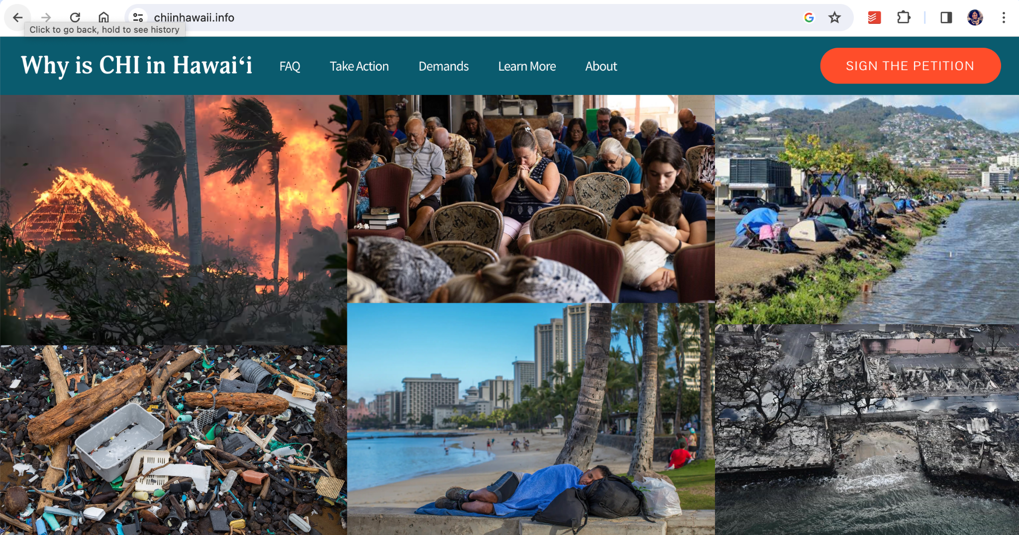

Slide 5
Our Response
From CHI SC
From CHI OC
From SIGCHI EC (medium.com/sigchi)
Site Selection Working Group
Hybrid Working Group
…

Slide 6
Thank You and Good Luck
neha.kumar@sigchi.org

